Slide 1
One Template to Rule Them All
Interactive Research Data Documentation with Quarto Moritz Mähr Moritz Twente

Slide 2
Open Research Data Template
Purpose: A reusable GitHub template for FAIR and open research data
Best Practices: Follows The Turing Way and FAIR principles
Automation: Leverages GitHub Actions, GitHub Codespaces, GitHub issues, GitHub Pages, Husky, Prettier, Quarto, Semantic Versioning, and Zenodo

Slide 3
Setup

Slide 8
Use cases

Slide 19
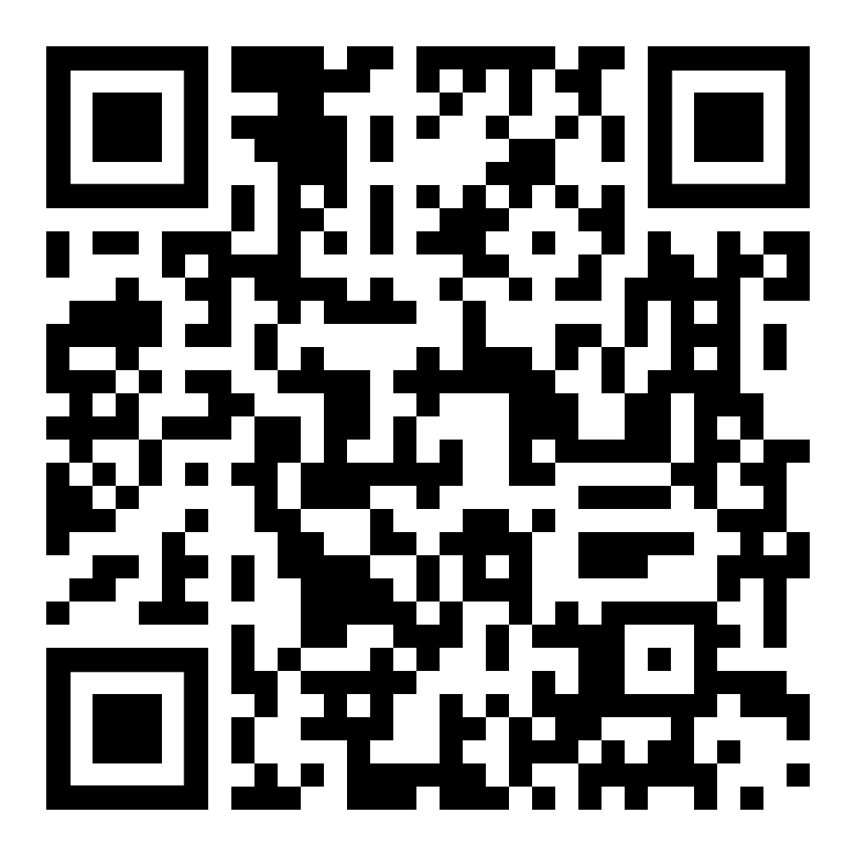
Get the template
https://github.com/maehr/open-research-data-template

